Slide 1
Flow Control Instructions
Course Code: CSC 2106
Course Title: Computer Organization and Architecture
Dept. of Computer Science
Faculty of Science and Technology
Lecturer No: | 6.1 | Week No: | 8 | Semester: | Summer 23-24
Lecturer: | Md. Faruk Abdullah Al Sohan; faruk.sohan@aiub.edu

Slide 2
Lecture Outline
  Decision making and repeating statement
  Jump and loop instructions
  Algorithm conversion to assembly language
  High-Level Language Structures

Slide 3
Jump and Loop
Jump and Loop instructions transfers control to another program
The transfers can be unconditional or
Depends on a particular combination of status flags settings
Conversion of algorithm is easier in assembly

Slide 4
Example of Jump
.MODEL SMALL
.STACK 100
.DATA
.CODE
MAIN PROC
MOV AH,2
MOV CX,256
MOV DL,0 ;ASCII of null
PRINT_LOOP:
INT 21H
INC DL
DEC CX
JNZ PRINT_LOOP
MOV AH,4CH
INT 21H
MAIN ENDP
END MAIN

Slide 5
Instruction | Meaning / Purpose | Explanation
.MODEL SMALL | Memory model | Program uses small model (separate code & data < 64 KB each).
.STACK 100 | Stack segment | Allocates 256 bytes of stack.
.DATA | Data segment start | No data is defined here.
.CODE | Code segment start | Begins program instructions.
MAIN PROC | Start of procedure | Entry point of program.
MOV AH, 2 | Setup display function | INT 21h/02h prints one character stored in DL.
MOV CX, 256 | Loop counter = 256 | Will run loop 256 times (for all ASCII values 0–255).
MOV DL, 0 | Start ASCII at 0 | DL = 0 (NULL), the first ASCII character to print.
PRINT_LOOP: | Loop label | Marks the start of the printing loop.
INT 21H | Print character | Prints the ASCII character currently in DL.
INC DL | Increment ASCII value | DL = DL + 1 → prints next character next time.
DEC CX | Decrease loop count | Stops after 256 prints.
JNZ PRINT_LOOP | Jump if CX ≠ 0 | Repeats loop until CX reaches 0.
MOV AH, 4CH | Program terminate call | Prepares DOS interrupt to exit program.
INT 21H | Exit program | Returns control to DOS.
MAIN ENDP | End of procedure | Procedure ends.
END MAIN | End of program | Tells assembler program entry is MAIN.

Slide 6
JNZ (Jump if Not Zero)
JNZ is the instruction that controls loop.
If result of preceding instruction is not Zero Then the JNZ transfers the control to the instruction at label PRINT_LOOP.
If the preceding instruction contains zero (i.e. CX=0) then the program goes to execute DOS return instructions.
PRINT_LOOP is the first statement label
Labels are needed to refer another instruction
Labels end with colon (:)
Labels are placed on a line by themselves to make it stand out.

Slide 7
Conditional Jumps
JNZ is an example of Conditional Jump Instruction:
JXXX destination_label
if the condition for the jump is true, the next instruction to be executed is at destination_label
If condition is false, the instruction following the jump is done next.
i.e. for JNZ if the preceding instruction is non-zero

Slide 8
Implementation of Conditional JUMP by
CPU
The CPU looks at the FLAGS register (it reflects the result of last thing that processor did)
If the conditions for the jump (combination of status flag settings) are true, the CPU adjusts the IP to point to the destination label.
The instruction at this label will be done next.
If the jump condition is false, then IP is not altered and naturally the next instruction is performed.

Slide 9
Example(cont’d…)
In the previous example:
The JNZ PRINT_LOOP is executed by inspecting ZF
If ZF=0 then control is transferred to PRINT_LOOP and continues
If the ZF=1 then the program goes on to execute next (i.e. MOV AH,4CH)

Slide 10
CMP Instruction
CMP destination , source
Compares the destination with source by computing contents
It computes by…
destination contents - source contents
The result is not stored but the FLAGS are affected
The OPERANDS of CMP may not both be Memory Locations
Destination may not be CONSTANT
CMP is just like SUB. However result is not stored in destination.

Slide 11
Signed Conditional Jumps
JG or JNLE | Jump if Greater than Jump if Not Less than or Equal to | ZF = 0 and SF = OF
JGE or JNL | Jump if Greater than or Equal to Jump if Not less than or Equal to | SF = OF
JL or JNGE | Jump if less than Jump if not greater than or equal | SF<>OF
JLE or JNG | Jump if less than or Equal Jump if not greater than | ZF = 1 or SF<> OF

Slide 12
Unsigned Conditional Jumps
JA or JNBE | Jump if Above Jump if Not Below or Equal to | ZF = 0 and CF = 0
JAE or JNB | Jump if Above or Equal to Jump if Not Below | CF = 0
JB or JNAE | Jump if Below Jump if not Above or Equal | CF = 1
JBE or JNA | Jump if Below or Equal Jump if Not Above | CF=1 or ZF = 1

Slide 13
Single-Flag Jumps
JE or JZ | Jump if Equal Jump if equal to Zero | ZF = 1
JNE or JNZ | Jump if Not Equal Jump if Not Zero | ZF = 0
JC | Jump if Carry | CF = 1 CF = 0
JNC | Jump if no Carry | CF=0
JO | Jump if Overflow | CF=1 or ZF = 1
JNO | Jump if No Overflow | OF=1
JS | Jump if Sign Negative | SF = 1
JNS | Jump if Non-Negative Sign | SF =0
JP/JPE | Jump if Parity Even | PF=1
JNP/JPO | Jump if parity Odd | PF=0

Slide 14
Conditional Jumps Interpretation
Signed JUMPs correspond to an analogous unsigned JUMPs (i.e. JG is equivalent to JA)
Signed jump’s operates on ZF, SF and OF
Unsigned JUMP’s operates on ZF and CF
Using wrong kind of JUMP can lead to wrong results. For example: for AX= 7FFFh and BX= 8000h
CMP AX,BX
JA BELOW
Even though 7FFFh>8000h in a signed sense, the program does not jump to label BELOW. Because
In unsigned sense (JA) 7FFFh < 8000h

Slide 15
Working with Characters
To deal with ASCII character set, either Signed or Unsigned jumps may be used.
  i.e. sign bit of a byte in a character is always zero.
However, while comparing extended ASCII characters (80h to FFh ), UNSIGNED jumps should be used

Slide 16
JMP Instruction
JMP instruction causes an unconditional transfer of control.
JMP destination
Destination is usually a label in the same segment as the JMP itself. [ref: appendix - F]
To get around the range of restriction of a conditional jump, JMP can be used.

Slide 17
High-Level Language Structures
Jump can be used to implement branches and loops
As the Jump is so primitive, it is difficult to code an algorithm with jumps without some guidelines.
The High-level languages (conditional IF-ELSE and While loops) can be simulated in assembly.

Slide 18
Branching Structures
Branching structures enable a program to take different paths, depending on conditions.
Here, We will look at three structures.
    1. IF-THEN
    2. IF-THEN-ELSE
    3. CASE

Slide 19
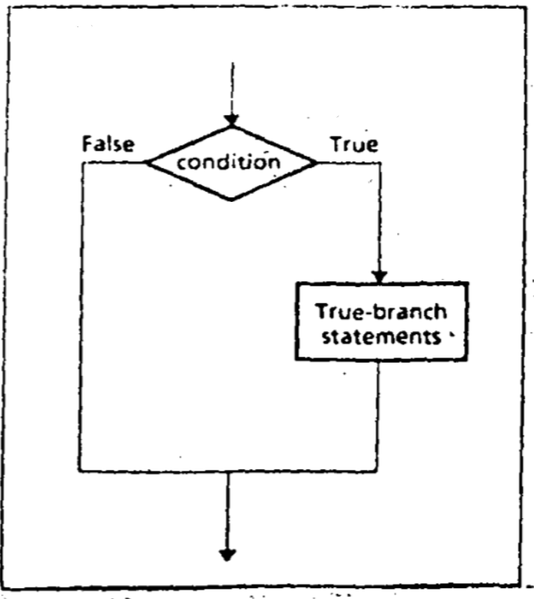
IF-THEN
IF condition is true.
THEN
execute true-branch statements
END_IF

Slide 20
A Pseudo Code , Algorithm and Code for IF-THEN
The condition is an expression that is either true or false.
lf It is true, the true-branch statements are executed.
lf It is false, nothing is done, and the program goes on to whatever follows.
Example: to Replace a number in AX by its absolute value…
IF AX < 0
THEN
replace AX by -AX
END_IF
CMP AX, 0
JNL END_IF
NEG AX
END_IF:

Slide 21
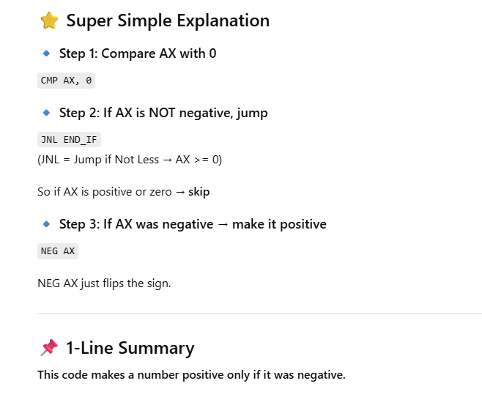

Slide 22
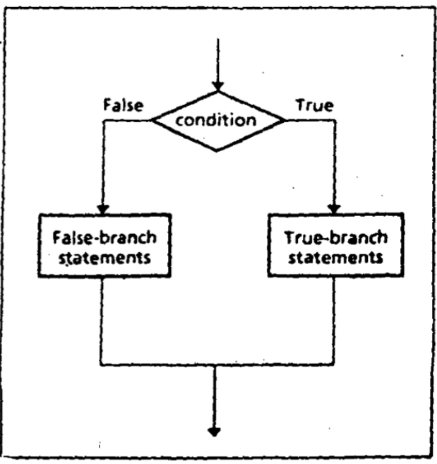
IF-THEN-ELSE
IF condition is true
THEN
execute true-branch statements
ELSE
execute false-branch statements
END_IF

Slide 23
A Pseudo Code and algorithm and Code for
IF-THEN-ELSE
The condition is an expression that is either true or false.
If It is true, the true-branch statements are executed.
If It is false then False-branch statements are executed.
Example: Suppose AL and BL contain extended ASCII characters. Display the one that comes first in the character sequence…
MOV AH,2
CMP AL,BL ;AL<=BL ?
JNBE ELSE_
MOV DL,AL
JMP DISPLAY
ELSE_:
MOV DL,BL
DISPLAY:
INT 2lh
IF AL <= BL
THEN
Display the character in AL
ELSE
Display the character in BL
END IF

Slide 24
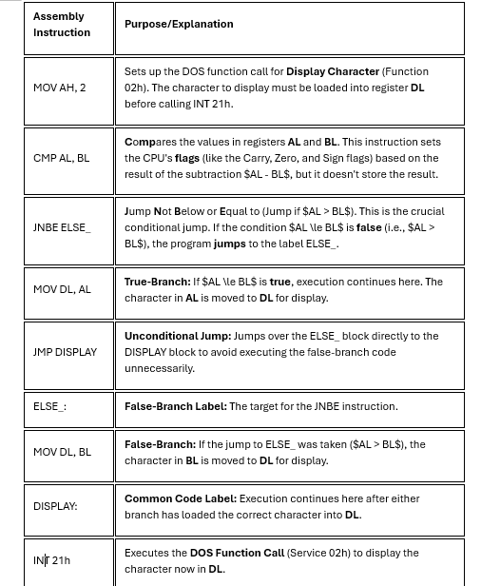

Slide 25
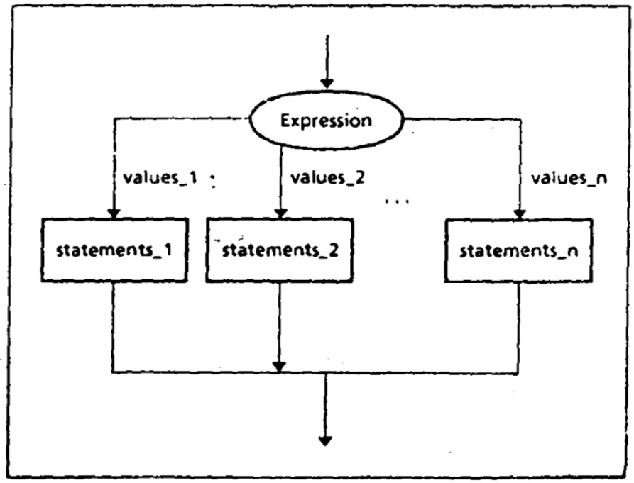
CASE
A CASE is a multi-way branch structure that tests a register, variable, or expression for particular values or a range of values.
      CASE Expression Values_1: Statement_1 Values_2: Statement_2
      … Values_n: Statement_n
      END_CASE

Slide 26
CASE
Example: If AX contains a negative number, put -1 in BX; if AX contains 0, put 0 in BX; and if AX contains a positive number, put 1 in BX.
CMP AX,O
JL NEGATIVE
JE ZERO
JG POSITIVE
NEGATIVE:
MOV BX,-1
JMP END_CASE
ZERO:
MOV BX,0
JMP END_CASE
POSITIVE:
MOV BX, l
END_CASE:
CASE AX
    <0 : put -1 in BX
    =0 : put 0 in BX
    >0 : put +l in BX
END_CASE

Slide 27
High-Level Logic (CASE AX) | Assembly Instructions | Description of Action | Result in BX
Initial Check | CMP AX, 0 | Compares the value in the AX register with 0. This sets the CPU status flags. | N/A
Case 1: AX < 0 | JL NEGATIVE | Jump Less: If the flags indicate $AX < 0$, execution jumps to the NEGATIVE label. | N/A
 | NEGATIVE: | Label for the negative case. | N/A
 | MOV BX, -1 | Move: Puts the value -1 into the BX register. | -1
 | JMP END_CASE | Jump: Unconditionally jumps past the other cases to END_CASE. | N/A
Case 2: AX = 0 | JE ZERO | Jump Equal: If $AX \ge 0$ (first jump failed) and the flags indicate $AX = 0$, execution jumps to the ZERO label. | N/A
 | ZERO: | Label for the zero case. | N/A
 | MOV BX, 0 | Move: Puts the value 0 into the BX register. | 0
 | JMP END_CASE | Jump: Unconditionally jumps past the remaining cases to END_CASE. | N/A
Case 3: AX > 0 | JG POSITIVE | Jump Greater: If $AX$ is neither less than $0$ nor equal to $0$, it must be greater than $0$. Execution falls through or jumps to POSITIVE. | N/A
 | POSITIVE: | Label for the positive case. (The jump is technically redundant here, as execution will fall through if the first two jumps fail.) | N/A
 | MOV BX, 1 | Move: Puts the value 1 into the BX register. | 1
Exit | END_CASE: | All execution paths converge here to continue the rest of the program. | N/A

Slide 28
Solve the Following
If AL contains 1 or 3, display "o"; if AL contains 2 or 4, display "e".
  CASE AL
      1,3: display ‘o’
      2,4: display ‘e’
  END_CASE

Slide 29
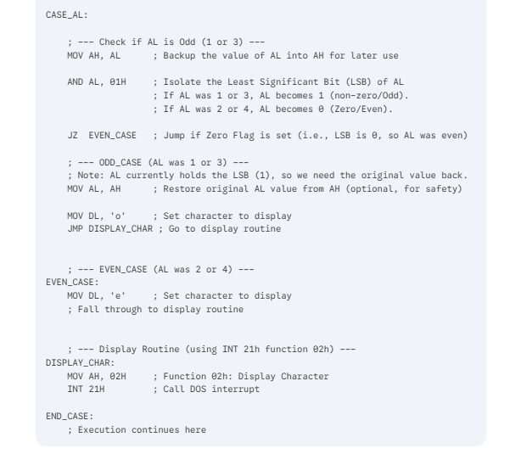

Slide 30
Class work
Write a program to check whether a given input character is a vowel or not.
Write a program to print all the capital letters.

Slide 31
References
Assembly Language Programming and Organization of the IBM PC, Ytha Yu and Charles Marut, McGraw Hill, 1992. (ISBN: 0-07-072692-2).
https://www.slideshare.net/prodipghoshjoy/flow-control-instructions-60602372

Slide 32
Books
Assembly Language Programming and Organization of the IBM PC, Ytha Yu and Charles Marut, McGraw Hill, 1992. (ISBN: 0-07-072692-2).
Essentials of Computer Organization and Architecture, (Third Edition), Linda Null and Julia Lobur
W. Stallings, “Computer Organization and Architecture: Designing for performance”, 67h Edition, Prentice Hall of India, 2003, ISBN 81 – 203 – 2962 – 7
Computer Organization and Architecture by John P. Haynes.

